Slide 1
Information Security Compliance
Copyright 2021 Tencent, Inc. or its affiliates. All rights reserved.

Slide 2
Chapter Objectives
After completing this chapter, you will be able to:
Understand generally accepted cloud security systems and standards;
Understand the security responsibility sharing principles of Tencent Cloud;
Understand the data lifecycle;
Understand Tencent Cloud data security solutions;
Understand access management in Tencent Cloud
Notes:
Training target: Cloud architects. To participate in this training, you need to learn the Tencent Cloud Architecture TCA course first.
This course requires basic theoretical knowledge of systems and basic theoretical knowledge of information security.

Slide 3
Section 1. Cloud Security Systems and Standards
CONTENTS
Section 2. Data Security Protection in Tencent Cloud
Section 3. Access Control Management in Tencent Cloud

Slide 4
Section 1. Cloud Security Systems and Standards
1.1 Basic cloud security principles
CONTENTS
1.2 Cloud security standards
1.3 Security responsibility sharing model
1.4 Tencent Cloud security system
Notes:
This chapter first introduces the basic principles of cloud security and the industry's main cloud security standards. Participants can use the principles and standards to measure whether the information security work of their own enterprises and adopted cloud providers is in place. To ensure cloud security, it is also necessary to clarify the boundaries of security responsibilities. This chapter will also introduce the Tencent cloud security responsibility model, and users must pay attention to the security areas for which their enterprises are responsible, and can enhance their own security capabilities with the help of the Tencent cloud security product system introduced at the end of the chapter.

Slide 5
1.1 Basic cloud security principles
Security protection of Attacks
Security objectives CIA
Surface
Confidentiality
Security protection
Security objectives
Cost
Effect
Integrity
Availability
Reduce
Ensure
Notes:
The risk types of cloud computing are defined using the classic "CIA triad" of Confidentiality, Integrity, and Availability, and relevant defense, detection, blocking, and remediation measures are proposed.
Confidentiality means that only authorized users can view receive access and process information.
Integrity means that the information is not illegally tampered with or destroyed during input, transmission, and storage and use, and ensures data consistency.
Availability means ensuring that authorized users are not improperly denied access to information and resources, and that they can access them in a timely and reliable manner.
Security defense requires measures to reduce the attack surface, increase the cost of attacks, and reduce the impact of attacks in order to safeguard the availability, integrity and confidentiality of systems and data.
Attack surface: points in the software or system that can easily be accessed or accessed by unauthorized users, such as networked devices, open ports, software system vulnerabilities, etc. The key to reducing the attack surface is the principle of minimal authorized use, not installing unnecessary software, reducing external contact points, and strictly limiting ports, IPs and user permissions.
Cost of attack: the cost of manpower, time and systems and money required by the attacker to launch the attack. The difficulty and cost of the attack can be increased by encrypting the transmission, detecting and preventing defensive countermeasures, etc.
Impact of the attack: the impact and damage caused by the attack. Systems are becoming more and more complex and technology is evolving at a rapid pace. Vulnerabilities are everywhere and attacks can't be prevented.

Slide 6
1.2 Cloud security standards
International certification standards: CSA STAR, ISO 20000:2018, ISO 22301:2012, ISO 27001:2013, ISO27002:2013, ISO27017:2015, ISO 27018:2014, and SOC 1, 2, and 3
Certification standards in the Chinese mainland: Trusted Cloud and Cybersecurity Classified Protection 2.0
Certification standards in other countries/regions: Cyber Essentials Plus (UK), DoD SRG (US), FIPS 140-2 (US), NIST 800-171 (US), IRAP (Australia), MTCS (Singapore), C5 (Germany), CS Mark (Japan), and K-ISMS (South Korea)
Notes:
International certification standards
CSA STAR: CSA STAR certification is a new and targeted international professional certification program, jointly launched by the British Standards Institute (bsi), the founders of global standards, and the Cloud Security Alliance (CSA), the international cloud security authority, to address specific issues related to cloud security. Security International Certification (CSA-STAR) is based on ISO27001 certification, combined with the requirements of the Cloud Security Control Matrix CCM, using the maturity model and assessment methodology provided by BSI, for any organization that provides and uses cloud computing, in terms of communication and stakeholder engagement; strategy, plans, processes and systematic approaches; technology and capabilities; ownership, leadership and management; oversight and Measurement, and other five dimensions, to comprehensively assess the organization's cloud security management and technical capabilities, and ultimately give an independent third-party external audit conclusion.
'ISO 20000:2018': the "Information Technology Service Management System Standard" is an organization-oriented IT service management standard.
'ISO 22301:2012': Business Continuity Management System, can help enterprises to develop an integrated management process plan that enables them to identify and analyze potential disasters, help them to determine the threats to their operations caused by possible shocks, and provide an effective management mechanism to stop or offset these Threats, and reduce the loss to the enterprise caused by disaster events.
'ISO 27001:2013': promoted by the International Organization for Standardization (ISO), is a set of specifications for establishing an information security management system (ISMS) (Specification for Information Security Management Systems), which details the requirements for establishing, implementing and maintaining an information security management system, indicating the risk assessment criteria that the implementing organization should follow. Of course, to obtain the final certification from the certification body (certification of the ISMS established according to ISO27001), there is a series of corresponding registration and certification process. As a set of management standards, ISO27001 instructs the relevant personnel how to apply the ISMS, and its ultimate goal is also to establish an information security management system suitable for the needs of enterprises.
'ISO 27002:2013': provides guidelines and common principles for initiating, implementing, maintaining and improving information security management within an organization, and is closely related to ISO 27001.
'ISO 27017:2015': provides guidance on the implementation of information security controls that are closely related to cloud services.
'ISO 27018: 2014': ISO 27018 is the first international implementation of a protocol that focuses on securing personal data in the cloud. It is based on ISO Information Security Standard 27002 and provides guidance on the implementation of ISO 27002 controls applicable to Public Cloud Personally Identifiable Information (PII).
SOC 1, 2, 3': A framework report issued by the American Institute of Certified Public Accountants (AICPA) as a review of controls in service organizations, named the Service Organization Control (SOC) report. SOC 3 reports focus more on predefined standardized benchmarks for controls related to security, processing integrity, confidentiality or data center systems and information confidentiality.
Domestic Certification Standards
Trusted Cloud: Trusted Cloud Certification is a certification system for the cloud computing service industry organized by the Data Center Alliance and the Cloud Computing Open Source Industry Alliance and tested and evaluated by the China Academy of Information and Communications Technology (TAITRA), with the goal of establishing an evaluation system for cloud service providers and providing support for users to choose a secure and trusted cloud service provider. Trustworthy cloud service certification assessment aims to establish a trust system for cloud computing services.
Equivalence Protection 2.0: The level protection regulations are the basic regulations and basic state policies in China in the network information security industry, and are a reflection of the country's belief in network information security. After the promulgation of the "Network Security Law", the level protection regulations are also raised on the legal and regulatory aspects, equal protection 2.0 in 1.0 of the basic, pay more attention to multi-faceted active defense, dynamic defensive power, overall prevention and precise security protection, in addition to the basic provisions, but also enhance the cloud computing technology, mobile Internet, Internet of things technology, industrial control and Internet big data and other construction functions full coverage
Other national certification standards
UK: Cyber Essentials was introduced in 2014, and since October 2014, all ICT (information and communication technology) providers that handle sensitive and personal information for the UK central government have to be certified by Cyber Essentials. Essentials requires organizations to complete a self-assessment questionnaire, issued after verification by a recognized certification body; the second level of Cyber Essential Plus for security upgrades, mainly for the resilience and endurance of organizations facing external network and Internet attacks, requiring organizations to pass independent security control tests by recognized certification bodies to provide a higher level of protection.
United States
DoD SRG: The U.S. Department of Defense (DoD) Cloud Security Model (SRG) provides a standardized assessment and authorization process for Cloud Service Providers (CSPs) to obtain a DoD Provisional Authorization that can subsequently be used by DoD customers.
FIPS 140-2: Federal Information Processing Standards (FIPS) Version 140-2 is a U.S. government security standard that specifies requirements for cryptographic modules that protect sensitive information
NIST 800-171: In June 2015, the National Institute of Standards and Technology (NIST) issued Guideline 800-171, "Final Guidance for Protecting Sensitive Government Information Held by Contractors." The guidance applies to the protection of controlled unclassified information (CUI) on non-U.S. federal systems
Australia.
Through the Information Security Registered Assessor Program (IRAP), Australian government customers are able to verify that appropriate controls are in place and determine the appropriate model of responsibility used to address the Australian Signals Directorate (ASD) Information Security Manual (ISM) requirements.
Singapore: Multi-Tier Cloud Security (MTCS) is an operational Singapore Security Management Standard (SPRING SS 584:2013) based on the ISO 27001/02 Information Security Management System (ISMS) standard
Germany: The C5 Cloud Security (Cloud Computing Compliance Controls Catalog) standard review is a data protection standard initiated by the German Federal Office of Information Security and is recognized as the most comprehensive and stringent data protection standard in the industry for cloud services. 114 basic requirements cover physical security, asset management, operations and maintenance management, encryption to secret key management, and 17 other areas. The 114 basic requirements cover physical security, asset management, operation and maintenance management, authentication and access control, encryption to secret key management, and 17 other areas; there are also 52 additional items that impose higher requirements on penetration testing cycles, password management strength, and customer security management flexibility.
Japan: CS Mark Cloud Security Mark is the first Japanese security standard for cloud service providers (CSPs), based on ISO / IEC 27017 (International Code of Practice for Information Security Controls). This in turn is based on ISO / IEC 27002 for cloud services, which addresses information security in cloud computing and the implementation of cloud-related information security controls. CS Mark has been accredited by the Japan Information Security Audit Association (JASA), a non-profit organization established by the Ministry of Internal Affairs and Communications and the Ministry of Economy, Trade and Industry to strengthen information security in Japan.
Korea: (K-ISMS) is a certification supported by the Korean government and sponsored by the Korea Internet and Security Agency (KISA) under the Korean Ministry of Science and Information Communication Technology (MSIT). K-ISMS is a standard for assessing whether businesses and organizations can consistently and securely operate and manage their information security management systems to ensure that they are able to thoroughly protect their information assets.

Slide 7
1.2.1 CSA STAR
CSA 4.0 defines 13 fields in two categories and describes the challenges and measures for cloud security from the strategic and tactical perspectives.
Operation domains (tactics/technologies)
Management Plane and Business Continuity
Infrastructure Security
Virtualization and Containers
Incident Response
Application Security
Data Security and Encryption
Identity, Entitlement, and Access Management
Security as a Service
Related Cloud Technologies
Governance domains (strategies/policies)
Governance and Enterprise Risk Management
Legal Issues, Contracts, and Electronic Discovery
Compliance and Audit Management
Information Governance
Notes:
The other 13 domains that make up the CSA guide highlight areas of concern for cloud computing security to address strategic and tactical security pain points in cloud computing environments so that they can be applied to various combinations of cloud services and deployment models.
These domains are grouped into two main categories: governance and operations. The governance domain is broad in scope and addresses strategic and policy issues for cloud computing environments, while the operations domain is more focused on tactical security considerations and implementation within the architecture.
Governance and Enterprise Risk Management: The ability of an organization to govern and measure the enterprise risks associated with cloud computing. For example, precedent for breach of contract decisions, the ability of the subscriber organization to adequately assess cloud provider risk, the responsibility to protect sensitive data when both the subscriber and provider are at risk of failure, and how international borders impact these issues are all points of concern. Issues addressed in this governance domain include information and computer system protection requirements, legal and regulatory requirements for security breach disclosure, privacy requirements, and international law.
Legal issues: contracts and electronic proof
Compliance and audit management: Maintaining and demonstrating compliance with the use of cloud computing. This governance domain covers assessing how cloud computing affects compliance with internal security policies, and the different compliance requirements (regulations, statutes, etc.). It also provides some guidance on demonstrating compliance during the audit process.
Information Governance: Governance of data in the cloud. This governance domain addresses the identification and control of data in the cloud; and compensating controls that can be used to address the loss of physical control when data is migrated to the cloud.
Other items, such as who is responsible for data confidentiality, integrity, and availability, are also mentioned.
Domains
Management plane and business continuity
Protects the management platform and management structure used to access the cloud, including the web console and APIs, ensuring business continuity for cloud deployments.
Infrastructure Security
Core cloud infrastructure security, including network, load security, and hybrid cloud security considerations. This area also includes the security foundation for private clouds.
Virtualization and Container Technologies
Security for virtualization management systems, containers, and software-defined networks.
Incident Response, Notification, and Remediation
Appropriate and adequate incident detection, response, notification, and remediation. Attempt to describe some of the items that need to be met on both the subscriber and provider sides in order to initiate proper incident handling and forensics. This domain will help you understand the complexity that the cloud brings to your existing incident handling procedures.
Application Security
Protect applications running on or developed in the cloud. This includes whether it is feasible to migrate or design an application to run in the cloud, and if so, what type of cloud platform is most appropriate (SaaS, PaaS, or IaaS).
Data Security and Encryption.
Implement data security and encryption controls, and ensure scalable key management
Identity, authorization, and access management
Manage identities and leverage directory services to provide access control. The focus is on the issues organizations encounter when extending identity management into the cloud. This section provides insight into assessing an organization's readiness for cloud-based identity, authorization, and access management (IdEA).
Security as a Service
Provides third-party facilitation of security assurance, incident management, compliance certification, and identity and access oversight.
Related Technologies
Established emerging technologies that are closely related to cloud computing, including Big Data, Internet of Things, and mobile computing

Slide 8
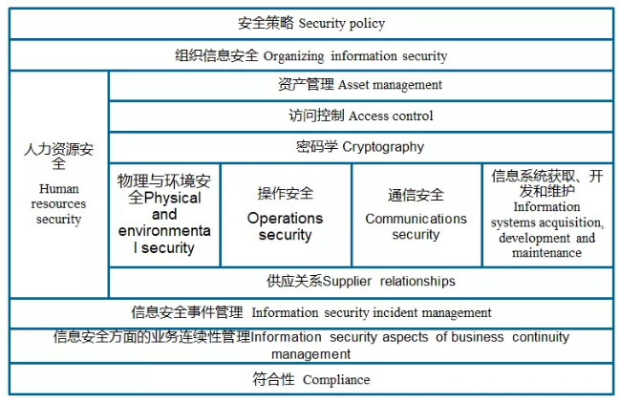
1.2.2 ISO 27001:2013
1.2.2 ISO/IEC 27001:2013
Notes:
ISO 27001:2013 covers the following areas
Security Policy. Specify the information security policy, provide management guidelines and support for information security, and review it periodically.
Organizational information security. Establish an information security management organization system to carry out and control the implementation of information security internally.
Asset management. Verify all information assets, classify information properly, and ensure that information assets are protected to an appropriate degree.
Human Resource Security: Ensure that all employees, contractors and third parties are aware of information security threats and related matters and their respective responsibilities and obligations to reduce the risk of human error, theft, fraud or misuse of facilities.
Access Control: Develop access control policies to avoid unauthorized access to information systems and make users aware of their responsibilities and obligations, including network access control, operating system access control, application system and information access control, monitoring system access and use, and regular detection of unauthorized activities; also ensure information security when using mobile office and remote control.
Cryptography: Use passwords to properly and effectively protect the confidentiality, authenticity and integrity of information.
Physical and environmental security: Define secure areas to prevent unauthorized access, damage and interference with office space and information; secure equipment to prevent loss, damage or theft of information assets and interference with business operations; and also, do general controls to prevent damage and theft of information and information processing facilities.
Operational security: establish operating procedures and responsibilities to ensure proper and safe operation of information processing facilities; establish system planning and acceptance guidelines to minimize the risk of system failure.
Communication security: protect the integrity of software and information by preventing malicious code and mobile code; manage information backup and network security to ensure that information is secure in the network and that its supporting infrastructure is protected; establish protocols for media disposal and security to prevent damage to assets and interruption of business activities; and prevent the loss, modification, or misuse of information and software when exchanged between organizations.
System acquisition, development and maintenance: mark the security requirements of the system, ensure that security becomes a built-in part of the information system, control the security of the application system, prevent the loss, modification or misuse of user data in the application system; protect the confidentiality, authenticity and integrity of information by means of encryption; control access to system files, ensure the security of system documentation, source code; strictly control the development and support process Maintain application software and information security.
Supply Relationships: Ensure the security of organizational information accessed by suppliers and maintain the information security requirements and service delivery levels agreed upon in agreements with suppliers.
Information Security Incident Management. Report information security incidents and vulnerabilities, take timely corrective action, ensure that information security incidents are managed using a consistent and effective approach, and ensure timely remediation.
Business Continuity Management: The purpose is to reduce the disruption of business activities, to protect critical business processes from major failures or natural disasters, and to ensure timely recovery.
Conformity: The design, operation, use process and management of information systems should comply with the requirements of laws and regulations, organizational security policies and standards, and also control system audits to maximize the effectiveness of the information audit process and minimize disruption.

Slide 9
1.2.3 Trusted Cloud Service Certification
The Trusted Cloud Service (TRUCS) certification is currently the only authoritative certification system for cloud services in the Chinese mainland.
16 metrics in 3 categories cover 90% of the issues set out in the SLAs for the services promised by cloud service providers.
Tencent Cloud has been awarded the TRUCS certification for multiple services, and it was also one of the first providers to pass the Trusted Cloud Gold Class Operations Special Assessment.
Data security
Data storage persistence
Data portability
Data confidentiality
Right to information about data
Data reviewability
Service quality
Business functionality
Business availability
Business resilience
Disaster recovery capability
Network access performance
Service measurement accuracy
Rights and interests protection
Service changes
Termination clauses
Indemnity clauses
User governing clauses
Notes:
What is Trusted Cloud Service Certification?
Trusted Cloud Service (TRUCS) certification is the only authoritative certification system for cloud services in China at present, jointly organized by Data Center Alliance and Cloud Computing Development and Policy Forum. Based on the principle of scientificity, TRUCS certification fully draws on advanced foreign experience and the practical experience of domestic cloud computing enterprises, and formulates three standards: "Reference Framework for Cloud Computing Service Agreement", "Evaluation Method for Trusted Cloud Service Certification", and "Operation Methods for Trusted Cloud Service Certification Evaluation". Its high specification and high standard have put forward higher requirements for domestic cloud service operators, and have an important positive effect on the standardization of the operation system of the cloud market and the expansion of the industry scale.
What is the specific evaluation content of the Trusted Cloud Service Certification?
In order to fully reflect the technical indicators and levels of cloud service providers, the specific evaluation content of the "Trusted Cloud Service" certification includes 16 indicators and many paragraphs in three categories, mainly including data management, business quality and rights and interests, the specific evaluation content includes: persistence of data storage, data destructibility, data migrability, data confidentiality, data right to know, data reviewability, business functions, business availability, business resilience, fault recovery capability, network access performance, service measurement accuracy, service change, termination clause, service compensation clause, user binding clause and service provider disclaimer.
What is the significance of trustworthy cloud service certification?
The content of the Trusted Cloud Service Certification basically covers 90% of the issues that cloud service providers need to promise or inform users (based on service SLAs), and the "Trusted Cloud Service" certification system evaluates the extent to which cloud service providers achieve these 16 indicators. The results of the certification assessment can be used by users to determine whether the cloud provider's promises are true and credible.
Tencent Cloud has successfully obtained the Trusted Cloud Service (TRUCS) certification, which means that Tencent Cloud's data storage persistence, data privacy, fault recovery capability, service availability and other indicators promised in the SLA meet the requirements of the Trusted Cloud Service certification and are transparent to users. It also provides an important basis for users to select secure and trustworthy cloud service providers.
According to the requirements of Trusted Cloud Service (TRUCS) certification, Tencent Cloud hosting service, cloud database service, cloud caching service, object storage service, local load balancing service, inter-data center VPN service, cloud distribution service and block storage service have passed the trusted cloud evaluation and certification of the Data Center Alliance. At the same time, Tencent Cloud has passed the special assessment of Trusted Cloud Gold Operation and Maintenance.

Slide 10
1.2.4 Cybersecurity Classified Protection 2.0
The architecture of Cybersecurity Classified Protection 2.0 consists of two parts (management and technology) and focuses on compliance.
Management requirements:
Policy and System Security
Organization and Resource Security
Human Resource Security
Construction Management Security
Maintenance Management Security
Technical requirements:
Physical Environment Security
Communication Network Security
Area Boundary Security
Computing Environment Security
Security Management Center
How are applications in Tencent Cloud graded? How are security responsibilities divided?
Notes:
Secure physical environment: security assurance and management of the server room facilities.
Secure communication network: including network architecture, communication transmission and trusted verification. It is required to ensure that the bandwidth of each part of the network meets the needs of peak business periods, and to provide hardware redundancy for communication lines, key network equipment and key computing equipment to ensure the availability of the system, while cryptographic technology should be used to ensure the confidentiality of data in the communication process.
Security area boundary: including boundary protection, access control, intrusion prevention, malicious code and spam prevention, security audit and trusted verification. It is required to be able to check or restrict the behavior of non-authorized devices connected to the internal network privately and internal users connected to the external network without authorization, and to restrict the use of wireless networks to ensure that wireless networks access the internal network through controlled boundary devices. At the same time, it should also detect, prevent or restrict network attack behaviors initiated from outside or inside at critical network nodes, and take technical measures to analyze network attacks, especially new types of network attacks, and record the attack source IP, attack type, attack target, and attack time when an attack is detected, and should provide alarms in case of serious intrusion events. In addition, malicious code and spam should be detected, removed and protected at key network nodes, and the upgrade and update of protection mechanisms should be continuously maintained, and separate behavioral audits and data analysis should be conducted for user behavior of remote access and access to the Internet.
Secure computing environment: including identity identification, access control, security audit, intrusion prevention, malicious code prevention, trusted verification, data integrity, data confidentiality, data backup recovery, residual information protection and personal information protection. Among them, the focus should be able to detect intrusions into important nodes and provide alerts in case of serious intrusions, and use technical measures against malicious code attacks or active immune trusted verification mechanisms to identify intrusions and virus behaviors in a timely manner and block them effectively. At the same time, verification technology or cryptographic technology should be used to ensure the integrity of important data during transmission and storage, including but not limited to identification data, important business data, important audit data, important configuration data, important video data and important personal information, etc., and to ensure that the storage space with sensitive data is completely cleared before it is released or reallocated.
Security management center: including system management, audit management, security management and centralized management. It is required to identify security administrators, allow them to perform security management operations only through specific commands or operation interfaces, audit these operations, and divide the
Specific management area to control the security devices or security components distributed in the network, and centralized monitoring of the operation status of network links, security devices, network devices and servers, etc. At the same time, the audit data scattered on each device is collected and summarized and analyzed centrally, and the retention time of audit records is ensured to meet the requirements of laws and regulations, and security-related matters such as security policies, malicious codes and patch upgrades are managed centrally, and various security events occurring in the network can be identified, alarmed and analyzed.
Network Security Level Protection System 2.0
Classification object: Separate cloud platform and business application
Responsible body: Cloud service providers and customers share security
Responsibility boundary: Different modes of security responsibility boundaries
Security area boundary introduced "access control" mechanism, that is, in the virtualization network boundary, different levels of network security area set access control rules, so that different people do their own scope of things

Slide 11
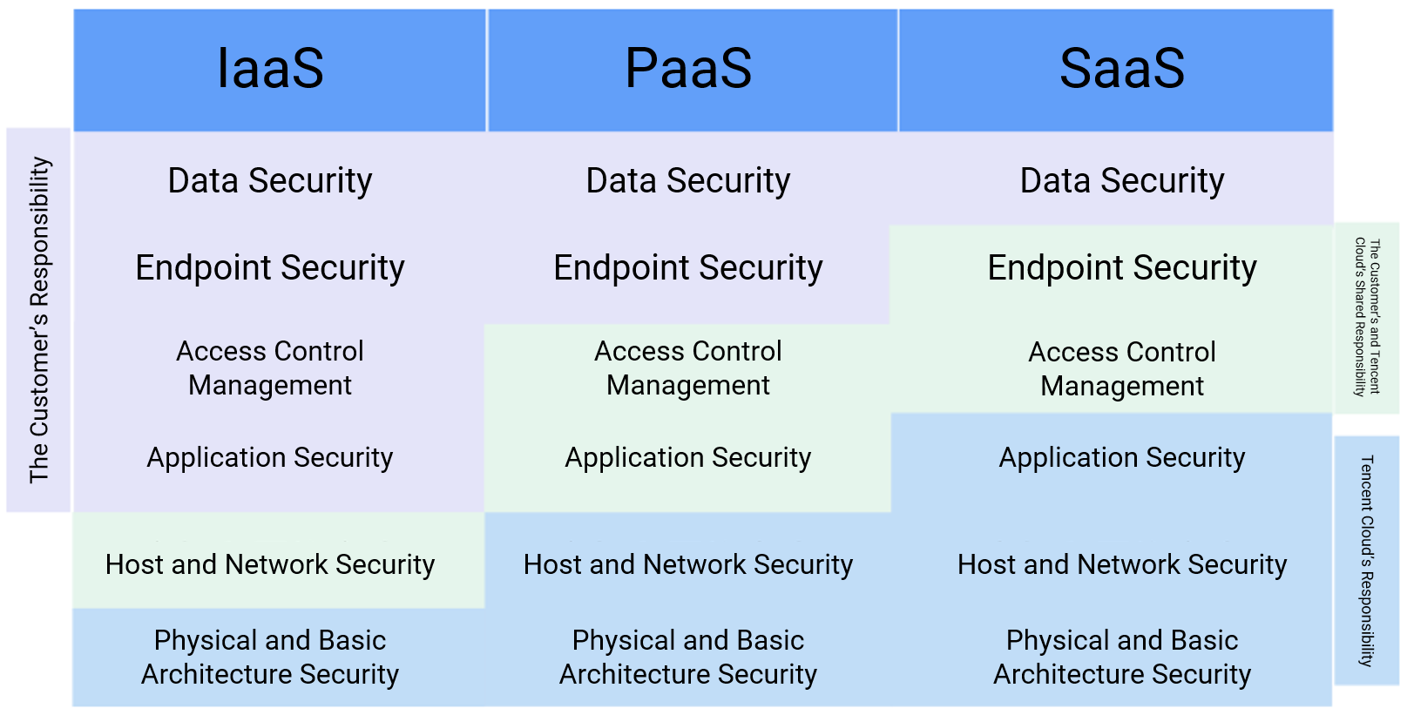
1.3 Security responsibility sharing model
Cloud security protection requires customers and cloud vendors to share responsibility and take effective measures for backup and protection.
Notes:
Tencent Cloud's security responsibility model follows industry standards and national legal requirements. Tencent Cloud has established the following shared responsibility model for information security based on information assets and product functions, in which the light blue part is defined as Tencent Cloud's responsibility, the light gray part is the customer's responsibility, and the light green part indicates that Tencent Cloud and the customer will share the corresponding responsibility.
Tencent Cloud Security Shared Responsibility Model.
Data security: refers to the security management of the customer's business data itself in the cloud computing environment, including collection and identification, classification and grading, permissions and encryption, etc..
Terminal security: security management of business-related operating terminals or mobile terminals, including hardware, systems, applications, permissions, and security controls related to data processing of terminals.
Access control management: management of access rights to resources and data, including user management, permission management, authentication, etc..
Application security: refers to the security management of business-related application systems in the cloud computing environment, including the design, development, release, configuration and use of applications.
Host and network security: refers to the host and network security management in the cloud computing environment, where the host level includes the underlying management (such as virtualization control layer, database management system, disk array network, etc.) and usage management (such as virtual host, mirror, CDN, file system, etc.) of cloud products such as cloud computing, cloud storage, cloud database, etc.; the network level includes virtual network, load balancing, security gateway, VPN and private links, etc.
Physical and Infrastructure Security: This refers to data center management, physical facility management, and physical server and network device management in a cloud computing environment

Slide 12
1.4 Tencent Cloud security system
Security management
Security Operations Center
Security Situation Awareness
Business Risk Intelligence
Security Governance
QAPIT
Server security
Network security
Data security
Application security
Business security
Cloud Workload Protection
Anti-DDoS
CloudHSM
Web Application Firewall
Register Protection and Login Protection
Security protection
Antivirus
Data Mask
Web Vulnerability Scan
DDTA
Captcha
Network Traffic Analysis System
Data Security Audit
Mobile Security
ActivityAntiRush
Cloud Shield-Data Data Access Security Broker
Mobile Tencent Protect
Moderation System
Advanced Threat Tracking System
Data Security Governance Center
Smart Application Gateway
AntiFraud
Basic security
The security features (such as server password management and encrypted data transfer) that come with Tencent Cloud services can meet customers' security baselines

Slide 13
Section 2. Data Security Protection in Tencent Cloud
Section 1. Evolution of Cloud Computing
2.1 Overview of data security
2.2 Data security responsibility sharing
2.3 Data creation security
CONTENTS
2.4 Data storage security
2.5 Data transfer security
2.6 Data access security
2.7 Data usage security
2.8 Data termination security
Notes:
Cloud security involves many directions, including host security, data security, network security, application security, and so on. This chapter will focus on the field of data security, based on Tencent Cloud's Data Shield solution, look at the key issues of data security and corresponding solutions from the whole data lifecycle, and introduce the basic methods of data backup planning. After studying this chapter, students can have an overall understanding of data security and master how to use Tencent Cloud products to build their own data security system.

Slide 14
2.1 Overview of data security
Enterprise data
Confidentiality
Technology
People
Integrity
Availability
Process
Notes:
Information security or data security has two opposing meanings: one is the security of the data itself, mainly refers to the use of modern cryptographic algorithms for active protection of data, such as data confidentiality, data integrity, two-way strong identity authentication, etc., and the second is the security of data protection, mainly the use of modern information storage means for active protection of data, such as through disk arrays, data backup, off-site disaster recovery and other means to ensure data security
Confidentiality: Secrecy, also known as confidentiality, is the protection of information about an individual or group from being accessed by others who should not have access to it. In computers, many software, including email software and web browsers, have secrecy-related settings to maintain the confidentiality of user information, and spy files or hackers may cause confidentiality problems.
Integrity: Data integrity is one of the three basic points of information security and refers to the process of transmitting and storing information or data in a way that ensures that it is protected from unauthorized tampering or can be quickly discovered after tampering. It is often confused with confidentiality boundary in the process of using in information security field. Take ordinary RSA encryption of numerical information as an example, a hacker or malicious user can change the value of numerical information accordingly by performing linear operations on the ciphertext without obtaining the key to crack the ciphertext. For example, if the transaction amount is $X, by multiplying the cipher text by 2, the transaction amount can be made 2X. also known as malleably. To solve the above problem, the ciphertext is usually protected using digital signatures or hash functions.
Availability: Data usability is a user-centered design concept. The focus of usability design is to make the design of the product conform to the habits and needs of the users.

Slide 15
2.2 Data security responsibility sharing
Customer
Users
Data security policies
Data protection measures
Data activity monitoring
Supporting services
Tencent Cloud
Basic services
Compute
Storage
Network
Database
Global infrastructure
Region
Availability zone
Cache node
Notes:
Data security on the cloud needs to be guaranteed by Tencent Cloud and users together.
Tencent's responsibility: securing the underlying cloud platform
Customer's responsibility: Just because data is an important asset for customers, the decision of what data to store in the cloud, whether to encrypt the data, who can access specific data and what credentials are required, and whether data backups are required in accordance with business requirements are all data security-related controls in the hands of the customer. Customers can configure their own data encryption means, access management functions, user authentication mechanisms, data backup and recovery tools, etc. provided by Tencent Cloud to ensure that their protection of data in the cloud meets business and compliance requirements.
Tencent Cloud's security services to customers: By providing a full range of diverse data security features, tools and controls to serve customers, Tencent Cloud works together with customers to build a better and more complete security system for cloud data.

Slide 16
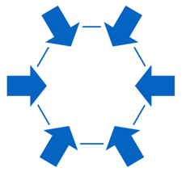
2.2.1 Tencent Cloud data protection principles
How does Tencent Cloud protect user data in the cloud?
Security audit
Equal protection
Tencent Cloud's perspectives on data security
Openness and transparency
Data privacy
Least privilege
Quality assurance
Notes:
What does Tencent Cloud do? Tencent Cloud follows the following principles within the scope of its own data security responsibilities.
Principle of equal protection: When Tencent Cloud protects data in the cloud, because it does not know what type of data customers have stored in the cloud, it adopts the same and highest level of security control measures for all customer data in the cloud, whether for enterprise users or individual users, in order to maximize the security of each customer's data.
Principle of openness and transparency: Tencent Cloud adheres to the principle of openness and transparency and promises that customers have the right to know the location of data storage and the extent of use and other information, including but not limited to.
Which data centers the data is stored in and the geographic location of the data center where the data is stored.
How many copies of the data are available, whether there is a cold backup, and the location of the data center where the backup data is stored.
Whether the data location is optional and, if so, the optional means
Informing the customer of the laws related to data security in the location of the data center.
The users of the customer's data and the type of data used.
Data privacy principle: Customer data belongs to the highest security level within Tencent Cloud. In Tencent Cloud, the control of customer data is entirely held by the customer. Tencent Cloud promises that Tencent Cloud internal staff will never touch any customer data on their own initiative, except in the following cases.
Required for the provision of services or troubleshooting, and expressly authorized by the customer
In accordance with national laws and regulations, such as investigations by national or local government departments regarding criminal incidents
At the same time, Tencent Cloud promises to ensure that customer data within the same resource pool is not visible to each other through effective isolation means, technically ensuring that tenants cannot access, acquire or tamper with other tenants' data.
Quality assurance principles: Tencent Cloud has set detailed service level indicators for the cloud services purchased by customers, and promises customers to provide high availability and high persistence data services through various security control measures and technical safeguards. Tencent Cloud specifies service availability and persistence indicators in the Service Level Agreement (SLA). If Tencent Cloud fails to meet the agreed upon service level agreement

Slide 17
Notes:
的服务保障，则腾讯云会按照该服务等级协议向客户承担补偿责任。如果客户对可用性的要求高于 SLA，客户可主动对自身系统进行高可用性的设置，腾讯云公司将给与必要的协助。
最小授权原则：腾讯云遵循权限最小化原则，只在客户授权范围内赋予内部员工为提供相应云服务所必需的最小的操作权限，非授权范围内的数据活动必须进行严格的授权审批。腾讯云从内部管理制度和自动化、工具化的运维管理平台层面双管齐下，杜绝客户数据非授权访问情况的发生。
安全审计原则：腾讯云对数据活动中的任何操作都进行相应的记录并且对日志信息采取严格的保护措施，确保所有的数据操作可以被追溯和审查。在安全审计方面，腾讯云凭借在大数据分析和人工智能领域的先进技术，开发了自动化审计工具，用于发现明显异常操作并及时响应。 同时，由安全专家组成的审计团队根据定制化的云安全控制活动项和实践经验亦会定期进行数据安全审计。

Slide 18
2.2.2 Data lifecycle
From which aspects should enterprises build their own data security capabilities?
Data creation:
Data storage:
Data transfer
Data access:
Data usage:
Data termination:
Sensitive data discovery
Data classification and grading
Data backup
Data encryption
Data transfer security
Permissions, authentication, and operation audit
Proper data usage, ciphertext processing, data desensitization, and data traceability
Media usage management, data termination management, and media termination
How do enterprises use tools and technologies to improve their own data security capabilities in Tencent Cloud?
Notes:
Improve data security capability from four aspects: system process, personnel capability, organization construction, and technology tools
In the entire data lifecycle of "data creation, data storage, data transmission, data access, data use and data destruction", data are protected by systems and tools and technologies for different scenarios.
Enterprises themselves build a security system throughout the data lifecycle, which requires a lot of manpower and development, with high costs and technical difficulties, and can rely on Tencent Cloud's security product system to make up for the shortcomings in enterprise information security.

Slide 19
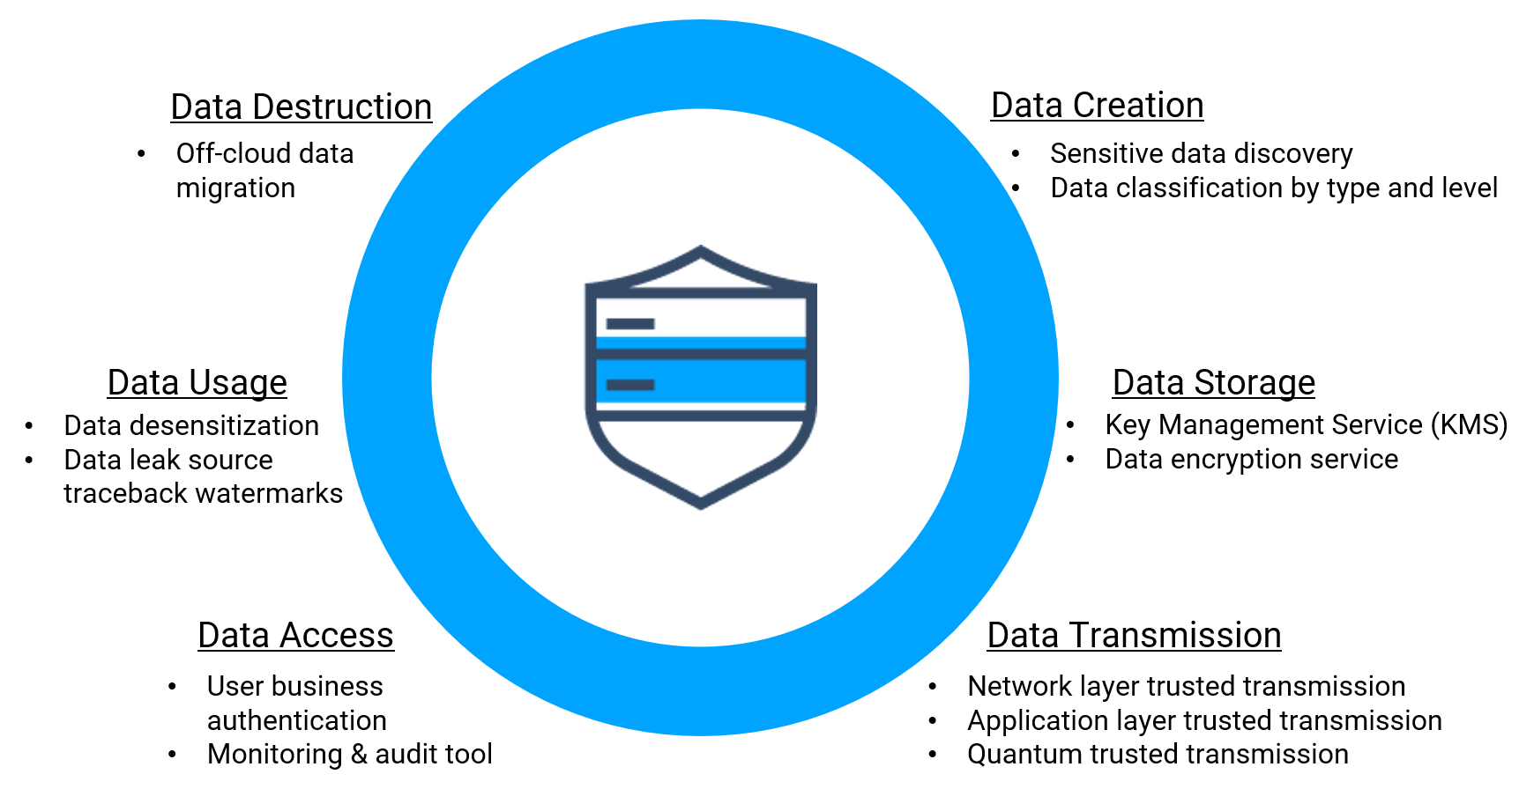
2.2.3 Addressing data security issues through Tencent Cloud services
Notes:
Tencent has built a comprehensive system of data security products - Data Shield - that users can use to protect their data in all aspects.
As a set of "Data-Centric Audit and Protection (DCAP)" solutions, Data Shield not only applies different security protections for each stage of the data lifecycle, including creation, storage, transmission, access, use and destruction, but also Through the implementation of password encryption, dynamic encryption of big data, identity management, authentication management, authorization management, real-time protection, audit and early warning, and other functions, it can provide systematic security protection with Tencent Cloud's full-process security ecosystem. In addition, Digital Shield also creates a unique six-key end-to-end authentication mechanism, provides PB-level big data processing capability and 100 billion level access request auditing capability, and is equipped with a full set of APIs and module components, making it possible to access the rich protection capabilities and architecture simply and quickly and put them into use after simple configuration.
The following will introduce the basic knowledge of data security and how users can protect their data on the cloud with Tencent Cloud at each stage of the data life cycle.

Slide 20
2.3 Data creation security
Data creation security
1
Sensitive data discovery
2
Data classification and grading
Notes:
Tencent Cloud provides sensitive data discovery and data classification and grading capabilities at the data creation stage.

Slide 21
2.3.1 Sensitive data discovery
Data types:
Data sources:
Scanning:
Identification:
Sensitive data:
Structured data
Unstructured data
Enterprise internal data
User data
Other data
How do we identify sensitive data?
29 built-in sensitive data identification rules
Custom sensitive data types
Personally identifiable information
Organizational documents
Intellectual property
Notes:
What is sensitive data: Sensitive data mainly includes technical information with intellectual property rights, internal documents of the organization, personal information and other high-value data, which exist in different forms in the information system of the enterprise. The leakage of sensitive data can bring serious economic loss to enterprises and may violate laws and regulations on personal privacy protection. Enterprises need to identify sensitive data in their own data assets and deal with it.
Challenges for enterprises in doing sensitive data discovery.
Unfamiliar with the requirements of GDPR (EU General Data Protection Regulation), hierarchical protection regulations, etc.
With the increase of enterprise data volume, manual identification requires a lot of manpower and has a higher probability of oversight
How can sensitive data discovery be better achieved.
Combined with Tencent's experience in big data analysis and the sensitive data discovery rules of different industries, Tencent Cloud's sensitive data discovery service automatically senses customers' data assets with self-developed scanning tools and accurately identifies sensitive data assets such as personally identifiable information, organizational documents and intellectual property retained in the enterprise IT environment. The service can analyze both structured and unstructured data to help customers identify sensitive data and ensure data visibility, avoiding the heavy workload of sifting sensitive data from the massive amount of data by customers themselves.
Tencent Cloud Product-Sensitive Data Processing supports up to 29 built-in sensitive data identification rules, covering the laws and regulations related to personal information protection in many countries, including China, the US and Europe. On the basis of compliance, it can identify sensitive attributes of all fields in the data set, ensuring that sensitive information hidden in large segments of text is not missed. At the same time, the product also supports automatic discovery of custom sensitive data types to meet users' personalized data protection needs. Hierarchical Protection Regulation, GDPR (EU General Data Protection Regulation)
Data Security Governance Center (DSGC) is a Tencent Cloud product that locates and classifies sensitive data on the enterprise cloud through data asset awareness and risk identification, and helps enterprises set data security policies to address risk issues and improve the effectiveness of protective measures. DSGC is a total solution that integrates other Tencent Cloud data security products.

Slide 22
Notes:
产品使用：敏感数据处理目前支持处理MySql、MariaDB、TXSQL、TDSQL、SQLserver、Oracle、postgreSQL 等多种数据库的数据，使用需要打通对应VPC的网络，将数据库所在服务器的信息在控制台CDS-Mask 上进行添加；数据安全治理中心目前公测中，需要和腾讯云联系进行使用。

Slide 23
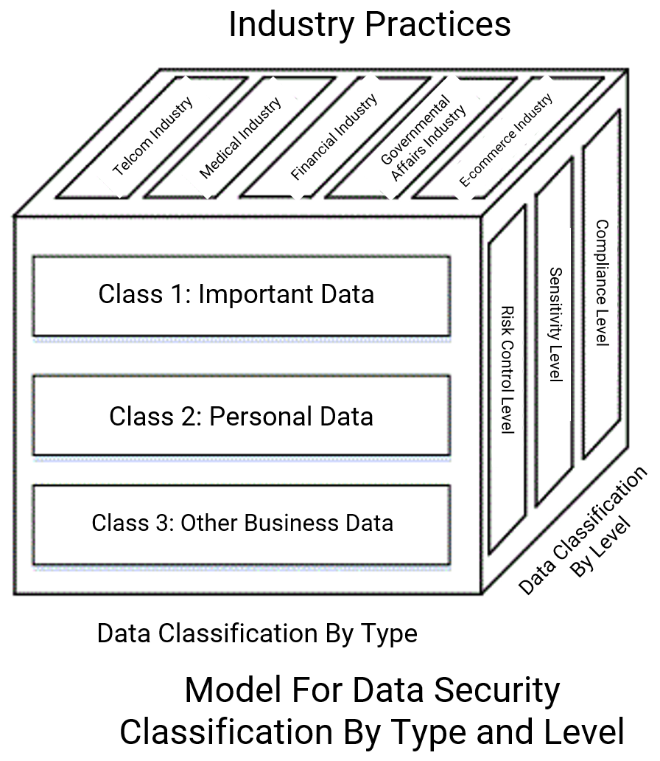
2.3.2 Data classification and grading
Complexity of data classification and grading
Data Security Governance Center
Automatically classify and grade data according to rules
With Tencent Cloud services
Visualize sensitive information through graphical reports
Enterprises improve data protection measures
Administrators develop different protection measures for data at different levels
Notes:
Why do data classification and grading: Data protection means, such as backup, encryption, permission control, etc., need to invest additional IT resources, and from the cost point of view, enterprises will not provide the same protection strength for all data. In order to balance the input-output ratio, it is necessary to classify and grade data according to the enterprise's own data security policy and corresponding laws and regulations, and then develop protection measures separately. Based on the results of sensitive data discovery, enterprises can further classify the data.
Referring to the data security classification and grading model, three dimensions can be cut from the following.
Industry practice: different industries, there are different methods of classifying data, on the one hand due to the large differences in data held, on the other hand due to the specific legal and regulatory constraints of different industries, especially finance and government, can be based on the relevant regulations and practices of the industry
Data classification: important data, personal information data, other business data
Data grading: divide risk control level, sensitivity level and compliance level, and formulate different protection measures for different levels of data
The challenges of data classification and grading: whether the large volume of data can be automated with tools; whether enterprises themselves are unfamiliar with industry practices, and whether they have a deep understanding of regulations, making it difficult to set their own standards.
What can Tencent Cloud do to help users in data classification and grading?
Data Security Governance Center can discover sensitive data in the data assets on the enterprise cloud, visualize the instances of storing sensitive data, sensitive data types, sensitive levels and other information, help enterprises more effectively sort out personal privacy data required by the level protection regulations, GDPR and other regulations, and assist in their security construction, helping enterprises to meet compliance requirements more smoothly.
The Data Security Governance Center product automatically classifies and grades the sensitive data found, relying on the product's built-in rules or user-defined rules to classify and grade the sensitive data found, and visualizes the global categories and levels of sensitive information through graphical reports and text lists. It allows enterprise managers to fully understand the proportion of sensitive data composition and the proportion of sensitive data in each data system instance. It enables enterprise managers to better adjust the protection measures of each data system instance, strengthen the protection of instances with high data sensitivity level, and ensure the security of enterprise core data. The product is in public test, and you need to contact Tencent Cloud team for application.

Slide 24
2.4 Data storage security
Data loss caused by failures
Failures in or faulty operations on applications: configure a backup mechanism
Data leakage caused by hacker attacks
Encrypt important data

Slide 25
2.4.1 Backup policy development
Backup considerations
Backup modes
Business requirements for data security and availability
Full backup
Amount of the data to be backed up
Balance between the input and output (media, hardware, and network) of data protection
Differential backup
Incremental backup
Backup time, which should not affect other work
Amount of traffic the network needs to handle during backup or recovery
Notes:
The choice of backup strategy requires consideration of the total data volume to be backed up, network bandwidth, data throughput, time window, and the requirement for recovery time. The current backup methods are full backup, incremental backup and differential backup, and we generally use multiple backup methods when developing a backup strategy.
Full backup: A complete backup of your data. The latest backup file can be used directly when restoring.
Incremental backup: Only backup the data that has been added and modified since the last backup. It is more troublesome to restore data, and you need to use multiple incremental backup files to do multiple data recovery.
Differential backup: Backup the newly added and modified backups after the last full backup. When restoring, you only need to use the full backup file plus the latest differential backup file to restore.
Plan backup frequency and backup methods based on data hierarchy to reduce costs
The backup of database should have both full backup and archive log backup. Full backup can be adjusted in frequency by day according to data volume and importance; archive backup can be adjusted in frequency by hour and job initiation according to database recovery area space reservation, archive growth trend, data recovery time requirement, business system archiving characteristics and other aspects.
The file type data can be backed up using the traditional file replication method according to the specific data volume, and volume level replication using storage snapshots instead of file-based scan replication for large data volumes.
The distribution of system backup jobs and the backup time need to be reasonably adjusted with the specific backup window. The backup jobs of critical business systems cannot affect the normal business and need to have mandatory constraints to limit the backup job time span. Especially for full backup, as the business continues to grow, the data volume will increase day by day, and if no adjustment is made to the backup jobs, it is likely that the original backup jobs will exceed the backup window and affect the business performance.
Manage all backup jobs in a hierarchy based on specific data types and business importance. Some data needs to be backed up continuously, while some data may only need to be backed up on special change days

Slide 26
2.4.1 Backup policy development (continued)
Business requirements for data:
T1
Disaster occurrence
T2
System recovery and operation
T3
Access recovery
Time
Recovery point objective (RPO)
- Data integrity
Recovery time objective (RTO)
- Application integrity
Network recovery objective (NRO)
- User access to application
Scheduled replication
Sync replication
Scalable cluster
Tape restoration
Second/Minute
Hour/Day/Week
Day
Hour
Minute
Second
Cost increase
Cost increase
Async replication
Tape backup
Manual migration
Notes:
The aspects to be considered in developing a backup strategy were mentioned earlier. According to the requirements of business continuity, the following three objectives can be further quantified indicators to be considered when setting a backup strategy.
RPO: (Recovery Point Objective) refers to the maximum amount of data loss allowed by the business system during a disaster, and is used to measure the data redundancy backup capability of the disaster recovery system.
RTO: (Recovery Time Objective) refers to the time required for an information system to recover from a disaster state to an operational state, and is used to measure the business recovery capability of a disaster recovery system.
NRO: When a disaster occurs, the time required for end users to switch to the backup network system and have access to the disaster recovery center through the backup network.

Slide 27
2.4.2 Data storage encryption algorithms
Symmetric encryption algorithms
SM1, SM4, DES, and AES
Asymmetric encryption algorithms
SM2, RSA-1024, RSA-2048, etc.
Digest algorithms
SM3, MD5, SHA1, SHA256, and SHA384
CloudHSM supports data encryption algorithms that meet national and industry standards
Notes:
For data in storage state, Tencent Cloud recommends that customers should adopt stricter and more secure protection measures for identified important or sensitive data, such as data storage encryption and database table encryption, in accordance with the results of data classification and grading, to avoid data leakage. As the most basic line of defense for data security protection, storage encryption can significantly raise the cracking threshold of library draggers and thus protect the confidentiality of data.
Symmetric encryption algorithm means that the same key is used for encryption and decryption
DES (Data Encryption Standard): data encryption standard, faster, suitable for encrypting large amount of data
AES (Advanced Encryption Standard): Advanced Encryption Standard, a next-generation encryption algorithm standard with high speed and high security level.
The asymmetric encryption algorithm requires a public key and a private key.
RSA: a public key algorithm invented by RSA that supports variable-length keys and requires encryption of file blocks of variable length.
Abstract algorithm, also known as hash algorithm, encryption process does not require a key and is generally used for digital signatures
Choice of encryption algorithm
Data volume.
The operation speed of asymmetric encryption algorithm is slower than that of symmetric encryption algorithm, and when the data volume is large, it is recommended to use symmetric encryption algorithm to improve the encryption and decryption speed.
The key management of symmetric encryption algorithm is a complicated process, when the data volume is very small, we can consider using asymmetric encryption algorithm.
Key length: the longer the key is, the slower the encryption and decryption speed will be, it should be chosen according to the security level, generally speaking, RSA is recommended to use 1024-bit numbers, AES can use 128-bit

Slide 28
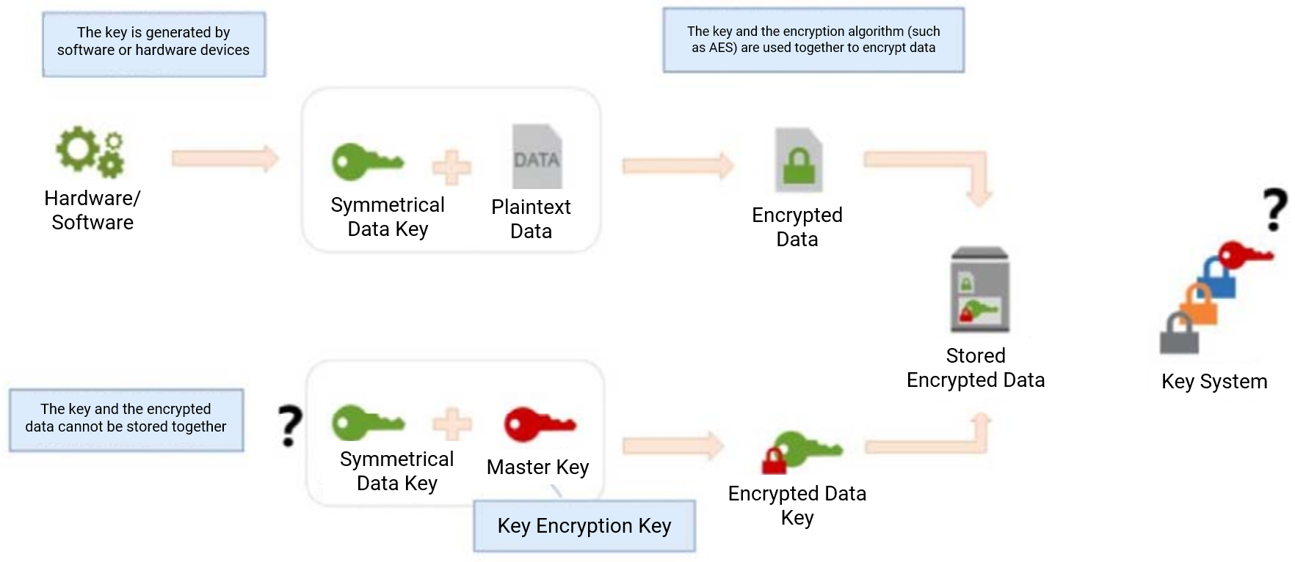
2.4.3 How data encryption works
Key Management Service (KMS) CloudHSM
Notes:
Data Encryption Basics
Basic implementation process of data encryption and key management: Symmetric data keys are generated by software or hardware devices. Symmetric keys are preferred over asymmetric keys for fast encryption of data of arbitrary size. The key is used in combination with an encryption algorithm (e.g. AES) and the generated ciphertext is stored. The symmetric key is stored in a different place from the encrypted data. You need to protect this key, and the best practice is to use another key to encrypt the data key, called a "key encryption key". It can be either a symmetric key or an asymmetric key, but it needs to be exported and stored in a separate system from the data processing system. After using the key encryption key to encrypt the data, the produced ciphertext can be stored with the encrypted data.
For a key encryption key, you can perform the process of encrypting this key with other keys as many times as needed, thus creating a key system. Sometimes you need access to the plaintext key that started the "unsealing" process in order to derive the final data key to decrypt the data. The location and access control of this key should be separate from the location and access control used for the original data.
Enterprises need to use hardware and software devices to generate keys and manage them. It is time-consuming and laborious to build from scratch by yourself, so you can directly purchase Tencent Cloud related services.

Slide 29
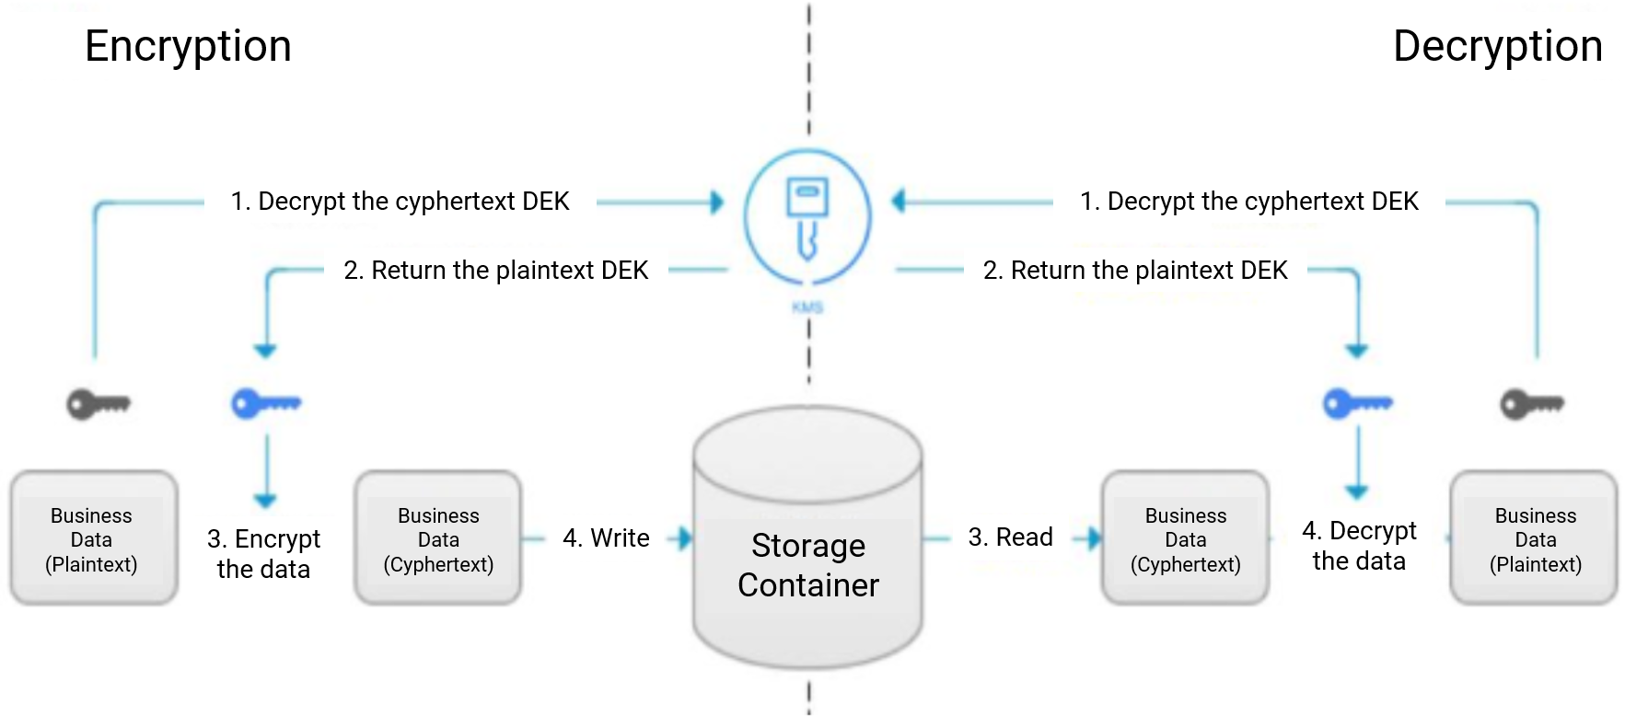
2.4.4 Data encryption with Tencent Cloud services
Key generation and protection based on HSM
Integration with the encryption features of COS and TDSQL
Integration with CAM and CloudAudit
Notes:
Data encryption using Tencent Cloud: data encryption service and key management service.
Since traditional physical cryptographic machines cannot be deployed directly on Tencent Public Cloud, Tencent Cloud also provides complete data encryption services under the same VPC network in order to facilitate customers to seamlessly interface with their businesses and products on Tencent Public Cloud. Tencent Cloud's data encryption service uses physical encryption machines (HSM) certified by the State Secrets Bureau, and supports a variety of data encryption algorithms that comply with national and industry standards. Tencent Cloud only provides technical support for encryption and decryption, while the use of the key and the authentication of the identity of the service are completely controlled by the customer. The data encryption service can help customers completely eliminate the occurrence of sensitive data stored in plain text, greatly increasing the difficulty of unauthorized visitors to access sensitive information. It is worth mentioning that, through the virtualization technology of cloud service cryptographic machine, Tencent Cloud provides more flexible, highly available and high-performance data encryption and decryption and key management services than traditional physical cryptographic machines, helping customers to achieve the protection of important business data more easily.
Envelope Encryption is a high-performance encryption and decryption solution for massive data. In the envelope encryption scenario of key management service, only the data encryption key DEK (Data Encryption Key) needs to be transmitted to the key management service (encryption and decryption are performed through the customer's master key CMK), and all business data are processed with efficient local symmetric encryption, which has little impact on the business access experience. Users can encrypt all core data by data key and save it in the corresponding storage container, and the data key is then encrypted by key management service to provide double protection for core data. At the same time, people lacking effective authority cannot get the contents of the data key and data even if they get the ciphertext, so as to protect the core data from leakage.
Translated with www.DeepL.com/Translator (free version)

Slide 30
2.5 Data transfer security
Data transfer within enterprise
Firewall
Physical isolation
Network transfer from enterprise to public cloud
Direct Connect
VPN
Application access opened to the public network
Use of HTTPS protocol
External application access
VPC 1
VPC 2
Interconnection between enterprise and public cloud
Remote data center
Office area
Notes:
In the data transmission phase of Tencent Cloud, the security between the enterprise IDC and Tencent Cloud is ensured by dedicated lines and VPN, and the access to WEB applications is ensured by SSL certificates.

Slide 31
2.5.1 Trusted transfer at network layer
Transfer over Direct Connect
Achieves physical isolation from other internet traffic
Transfer over IPsec VPN
Encrypts the linkage with an IKE protocol-based preshared key
Remote data center
Other
cloud platforms
Internet
Office area
NAT gateway
Public gateway
VPN gateway
Direct Connect gateway
VPC 1
Subnet 1
Subnet 2
Subnet 3
Notes:
When the customer's office, third-party partners or downstream customers communicate with Tencent Cloud, the customer needs to choose the network access method of private line access, IpsecVPN or public Internet to conduct data transmission activities with Tencent Cloud, taking into account its own security needs and actual control capability.
Tencent Cloud Private Line Access is a private line network jointly provided by Tencent Cloud and network operators. Private Line Access can ensure that data communication between customers' corporate data centers and public cloud computing environment is always in an independent network link, achieving physical isolation from other Internet traffic and effectively defending against attacks such as network eavesdropping, network sniffing, network interception and network tampering. Its high security and stability features can meet the regulatory and compliance requirements of finance, government and enterprises.
Tencent Cloud IPsecVPN can provide customers with a secure transmission network on top of the Internet. It adopts IKE protocol pre-shared keys for link encryption, which can meet customers' network security requirements in most cases. In addition, Tencent Cloud IPsec VPN gateways adopt dual hot backup configuration and allow configuration of multiple VPN gateways to achieve higher bandwidth secure network access.
Internet Key Exchange (IKE) solves the problem of securely establishing or updating shared keys in insecure network environments (such as the Internet).

Slide 32
2.5.2 Trusted transfer at application layer
Challenges of HTTP:
The HTTP protocol is used to transfer information between web browser and website server
Data transferred over the HTTP protocol is unencrypted, i.e., in plaintext
HTTPS = HTTP + SSL
Transfer encryption guarantees data security;
Authentication guarantees website authenticity.
Mobile application
Portal
SSL certificate
Notes:
Hypertext Transfer Protocol HTTP protocol is used to transfer information between web browsers and web servers. HTTP protocol sends the content in plain text and does not provide any way of data encryption, so if an attacker intercepts the transmission message between web browsers and web servers, he can directly read the information in it, therefore, HTTP protocol is not suitable for transferring some sensitive information, such as credit card number, password and other payment information.
In order to solve this shortcoming of HTTP protocol, another protocol needs to be used: Secure Socket Layer Hypertext Transfer Protocol HTTPS. For the security of data transmission, HTTPS adds SSL protocol to HTTP, which relies on certificates to verify the identity of the server and encrypt the communication between the browser and the server.
HTTP: is the most widely used network protocol on the Internet, is a client and server-side request and answer standard (TCP), used to transfer hypertext from WWW server to local browser transmission protocol, it can make the browser more efficient, so that the network transmission is reduced. HTTP protocol transmission of data are unencrypted, that is, plaintext, so the use of HTTP protocol In order to ensure that these private data can be encrypted, Netscape designed the SSL (Secure Sockets Layer) protocol to encrypt the data transmitted by the HTTP protocol, which led to the birth of HTTPS. It is more secure than the http protocol.
HTTPS: is a secure HTTP channel with the goal of security, simply put, it is a secure version of HTTP, that is, HTTP under the addition of SSL layer, the security basis of HTTPS is SSL, so the details of encryption will require SSL. the main role of HTTPS protocol can be divided into two kinds: one is to establish an information security channel to ensure the security of data transmission; the other is to confirm the the authenticity of the website.

Slide 33
2.5.2 Quantum teleportation
Evolution of data transfer security
Classic communication
Quantum communication
Encryption algorithm
Quantum encryption
Encryption and decryption algorithms that seemingly cannot be cracked by current mathematical methods may be cracked in the future with the development of technology and the increase in computing power, and keys may be leaked and cannot be kept absolutely secure.
As information transferred by quantum teleportation will not be eavesdropped or copied during the transfer, quantum teleportation is an encryption technology that cannot be decrypted.
Notes:
Quantum communication refers to a new type of communication that uses the quantum entanglement effect for information transfer. Quantum communication is mainly based on the theory of quantum entangled states and uses quantum invisible transfer (transmission) to achieve information transfer. The process of optical quantum communication is as follows: a pair of particles with an entangled state is constructed in advance, two particles are placed on each side of the communication, and the particle with an unknown quantum state is measured jointly with the particle of the sender (an operation), then the particle of the receiver collapses (changes) instantaneously, collapses (changes) to some state, which is symmetric with the state of the particle of the sender after collapsing (changing), and then the The joint measurement information is then transmitted to the receiver through the classical channel, and the receiver transforms the collapsed particle according to the received information (equivalent to an inverse transformation) to obtain an unknown quantum state identical to that of the sender.
Quantum communication has some outstanding features compared to traditional communication methods, such as higher security and less obstruction in the transmission process. When the quantum state is not destroyed, it will not be eavesdropped or copied during the transmission of information, so it is strictly speaking, it is absolutely safe. And in unhindered transmission, two separated quanta, no matter how far apart they are, when one quantum changes, the other one will also produce a corresponding change.

Slide 34
2.6.1 Data access security
Pre-transaction
Mid-transaction
Post-transaction
Operation audit
Behavior analysis/user analysis
Access
User/Business authentication
Jump server
Database operation audit
CLS
Process improvement
Process improvement
Modeling
Early warning
External security protection
Notes:
Host security is a critical factor in preventing unauthorized access to cloud data. Tencent Cloud's "Host Security" product provides customers with powerful host security protection features. It is true that, in addition to host security, customers should strictly manage users' access rights to their cloud data to ensure that only specific personnel can perform specific operations on specific data. Tencent Cloud combines Tencent's many years of internal audit and internal control capabilities to provide a full range of user\business authentication services and monitoring and auditing tools for customers to use.
ISO 27001:2013 proposes that an access control policy should be established and reviewed based on business and access security requirements to provide only network access and network services that users have authorized.

Slide 35
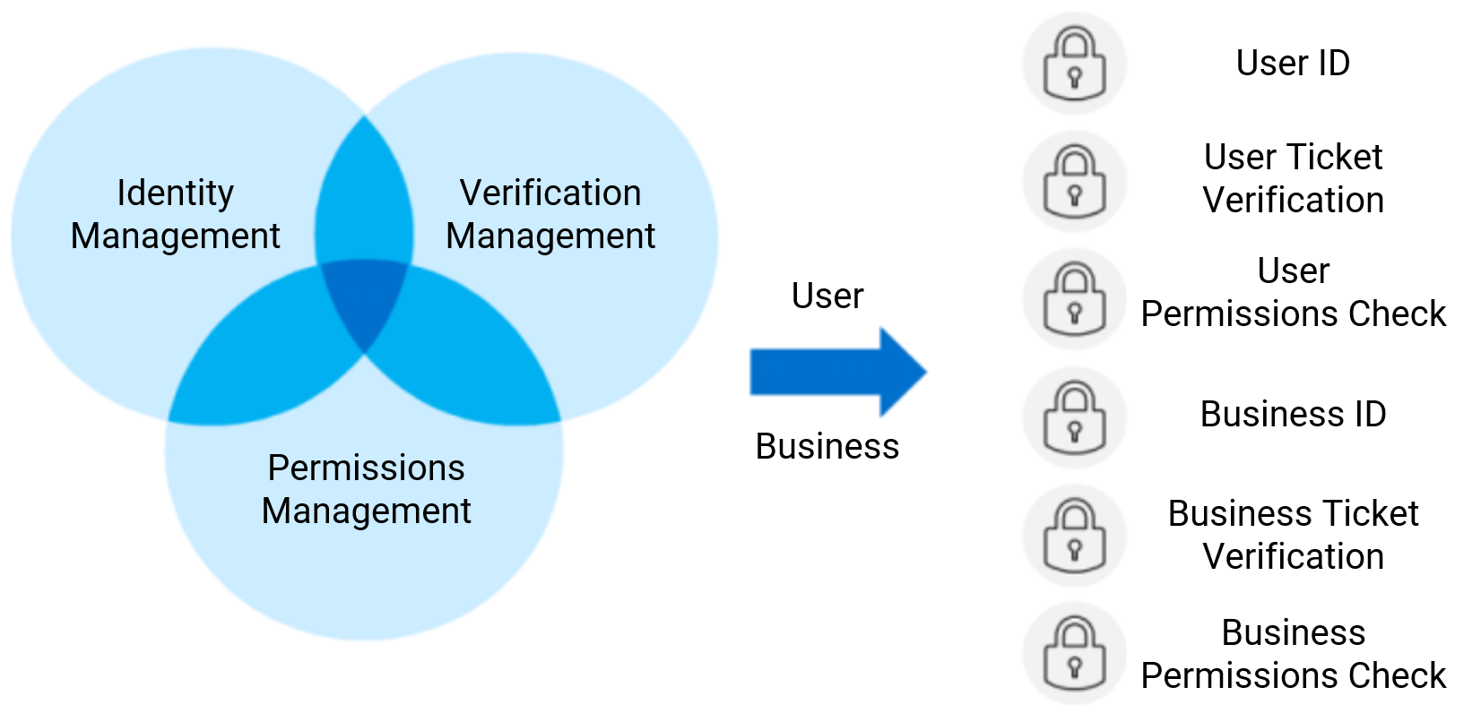
2.6.2 User/Business authentication
Notes:
To ensure legitimate access to data, Tencent Cloud provides a three-in-one user business authentication service with identity management, authentication management and authorization management. The end-to-end authentication system is formed through six keys: user ID, user ticket authentication, user authorization check, business ID, business ticket authentication and business authorization check to reduce the occurrence of unauthorized access to data in the cloud.
Taking the user side as an example, each Tencent Cloud user has a unique identifiable user ID in Tencent Cloud, and Tencent Cloud provides various user authentication mechanisms for different scenarios, including account password, multi-factor authentication, SSH key, etc.
Account password: When customers need to log in through the console or backend server, Tencent Cloud provides the most basic account password login function. Combined with Tencent's experience in managing passwords for QQ and WeChat accounts, Tencent Cloud accounts are equipped with strong password security policies to prevent attacks such as violent cracking.
Multi-factor authentication: For privileged accounts or sensitive operations, Tencent Cloud also provides multi-factor authentication for customers to conduct secondary identity identification. Customers can choose to open login protection and operation protection on the console. After users turn on MFA login protection, when they log in to the Tencent Cloud website, they are required to enter the dynamic security code from their MFA devices for secondary authentication after entering their user names and passwords. After the user turns on MFA operation protection, the user must complete the secondary verification by entering the dynamic security code from the MFA device when performing sensitive operations.
SSH key: When customers need to log in to the Linux cloud server, they can choose SSH key to securely connect to the cloud server in addition to logging in through the account password. Customers can create and manage their own SSH keys through the console, and only those who have the private key can log in to the cloud server for operation.

Slide 36
2.6.3 Security audit
OPS audit: how do we monitor the non-compliant operations of internal valid users?
Log
Operation logs can be obtained, but they are poorly readable and relatively scattered.
Jump server
Database audit system
It can be monitored and audited as the unified entry for OPS
The impact of log audit on the database itself is avoided
Notes:
Operation and maintenance audit: Malicious data requests may also exist in legitimate data access. In order to discover potential data security events in a timely manner, customers need to monitor access and operations involving customer data, use various technical means to collect and monitor the system status, security events, and network activities of each component of the network environment in real time, discover abnormalities and alert in real time, and at the same time take forced offline, lock the account Several emergency handling plans, such as mandatory offline, account lockout, etc., to avoid data leakage, tampering and other situations
Traditional database audit relies on the log audit method, there are many drawbacks, such as: database audit function will affect the operation of the database itself, the original massive data retrieval has overwhelmed the database; database log files themselves have the risk of being tampered with
Database audit system by monitoring all messages in and out of the database, through in-depth message parsing and reorganization technology to restore the hash of messages into a complete database statements, such as select, delete, alter, grant, etc., and then according to the corresponding rules to match them and according to the corresponding risk level of real-time alerts.

Slide 37
2.6.4 CloudAudit
CloudAudit:
Operations on Tencent Cloud resources
OPS security audit/jump server:
Operations on jump servers
Database operation audit:
Operations on TencentDB
CLS:
Integration of operation logs
Logging
Analysis
Modeling
Notes:
With years of accumulated experience in abnormal behavior monitoring, Tencent Cloud has established a comprehensive rule base and combined three AI engines for credit, behavior, and content to create a reliable O&M security audit tool and an end-to-end database operation audit tool to help customers better achieve security control and risk disposal.
Cloud Audit: CloudAudit CloudAudit is a service that supports supervision, compliance checking, operation auditing and risk auditing of Tencent Cloud accounts. With CloudAudit, you can record logs, continuously monitor and retain account activity related to operations across the Tencent Cloud infrastructure. cloudAudit provides an event history of Tencent Cloud account activity, including operations performed through the Tencent Cloud management console, API services, command-line tools and other Tencent Cloud services. This event history simplifies security analysis, resource change tracking, and issue troubleshooting.
Operation and maintenance security audit: Combined with Tencent's internal operation and maintenance security good practices, Tencent Cloud can help customers deploy a fortress machine within their cloud environment to centrally control Tencent Cloud account permissions. The customer's operation and management team can only use the newly granted account of the bastion machine and log in through secondary identity verification (e.g. dynamic authentication password) to automatically obtain the appropriate system operation authority. All backend operation and maintenance operation records are recorded with unified logs and automated security audits.
Cloud Shield-Data Data Access Security Broker combines fortress machine and artificial intelligence technology to provide enterprises with operation and maintenance personnel operation auditing, alerting on abnormal behavior and preventing internal data leakage.
Database operation audit: For core assets such as databases, Tencent Cloud provides high-performance database operation audit tools to help enterprises control the risk of possible unauthorized access to databases and improve data security level and compliance capability. Customers can open the database operation audit function through the console and customize the audit policy, and the SQL statements matching the audit policy will be displayed on the visual audit log page for customers to view directly.
Cloud Data Shield-Audit is an artificial intelligence-based database security audit system that can dig into all kinds of potential risks and hidden dangers in the database operation process to protect the safe operation of the database. Currently supported database types are MySQL, SQLServer, PostgreSQL, MongoDB, Oracle, Redis
Log service: To facilitate the traceability of data security events, customers need to record every data activity in the cloud in detail. Log service is a one-stop log data solution provided by Tencent Cloud. Customers do not need to pay attention to resource issues such as capacity expansion and reduction, and can enjoy a full range of stable and reliable log services from log collection and log storage to log content search and statistical analysis with five minutes of fast and convenient access. Tencent Cloud's Log Service helps customers easily solve business problem location, security audit and other log-related issues, greatly reducing the threshold of log operation and maintenance.
Cloud Log Service (CLS) is a one-stop log service platform provided by Tencent Cloud, which provides a number of services from log collection and log storage to log retrieval and analysis, real-time consumption, and log delivery, assisting users to solve business operations, security monitoring, log auditing, log analysis, and other issues through logs. Users do not need to concern about resource expansion, and can enjoy stable and reliable log service with five minutes convenient access.
Through the log service Agent collects logs to the log service, and through the log query capability, it can quickly analyze its access behavior, such as the operation record of an account or an object, to determine whether there is a violation operation, and through the log delivery object storage COS can also store the log data for a long time to meet the compliance audit requirements.

Slide 38
2.7 Data usage security
Data usage security
1
Overview of data usage security
2
Data masking
3
Watermark for leakage traceability
Notes:
腾讯云在数据使用阶段，基于“敏感数据处理”产品提供敏感数据脱敏和泄露溯源水印服务。

Slide 39
2.7.1 Overview of data usage security
Is there any sensitive information?
Enterprise data
Watermarking
Masking
Normal disclosure
Leakage
How do we conduct an investigation and pursue liability?
Notes:
In the process of data usage, desensitization of sensitive data can ensure the compliance of data usage. At the same time, during the stage of data outflow and release, watermarking can be superimposed on the data, which can be used for traceability, damage determination and evidence storage after data leakage.

Slide 40
2.7.2 Data masking
Static data masking: mask data for use in non-production environments
Dynamic data masking: mask data in real time, which takes effect upon user inquiry
Masking Algorithm | Description
Asterisking | Covers certain content with asterisk (*) in a specified way
Format-Preserving encryption (FPE) | Keeps the output ciphertext in the same format as the plaintext
Shuffling | Rearranges masked fields in a random or shifted manner
Tokenization | Replaces real data with tokens and stores real data separately, so that only meaningless tokens can be accessed
k-anonymization | Requires any quasi-identifier to appear in at least k records. This makes it difficult to identify users through filtering and exclusion
Differential privacy | Adds noise to query results to distort them within a certain range and make the probability distributions of two adjacent databases almost the same
Notes:
Why data desensitization: To ensure that desensitized data cannot be restored by social workers or by crashing libraries, and to truly eliminate internal data leakage
Static data desensitization (SDM) is the primary method of protecting specific data elements in static data. Static data desensitization is usually used in non-production environment, such as data testing, in the case of customer security data or some commercially sensitive data, in order to prevent the leakage of these sensitive data, under the condition of not violating the system rules, the real data is transformed and provided for testing, such as ID card number, cell phone number, card number, customer number and other personal information need to be data desensitized.
Dynamic Data Desensitization (DDM), which performs dynamic and real-time desensitization of data, is usually used in production environments. It desensitizes sensitive data in real time without making any changes to the original data when users query it and returns the desensitized data to users.

Slide 41
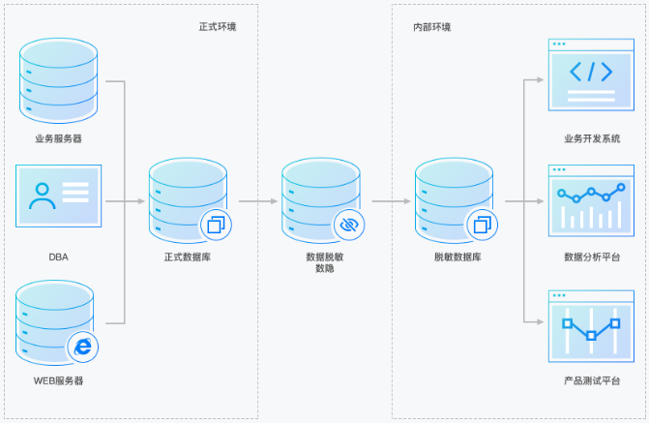
2.7.2 Data masking (continued)
Public
Private
Data Mask
Business Service
Business Development
Advanced masking algorithms are used to ensure that masked data cannot be restored by social engineering or credential stuffing, thus preventing the leakage of internal data
Masked Data
Data desensitization
Desensitised data
Data Analysis
Web Service
Product Test
Notes:
With the official implementation of the Cybersecurity Law, the state and regulators are paying more and more attention to the protection of personal information, and regulation has been strengthened time and again. To help customers meet various compliance requirements for data privacy protection, Tencent Cloud provides one-stop cloud-based sensitive data desensitization solutions. Customers can develop targeted data desensitization solutions according to different data usage scenarios (development, testing, analysis, etc.) and quickly deploy them in the cloud to directly desensitize sensitive data such as user identity information and codes for flexible invocation, greatly reducing the time and cost of the data desensitization process.
In R&D, testing and data analysis environments, developers do not need to use completely real data, but only need the data format to be consistent with the production environment. At this time, if the data provided by the data system is not processed, then the problem of uncontrollable core data boundary will arise. Developers who sell critical data for their own personal gain will have an incalculable impact on the enterprise. Sensitive data processing can desensitize the data in R&D, testing, and data analysis environments to eliminate internal leakage.

Slide 42
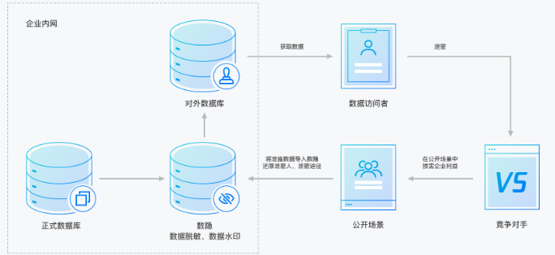
2.7.3 Watermark for leakage traceability
Intranet
Data Mask
Data retrieve
Data can be tagged by implicitly watermarking the dataset downloaded by each visitor, so that the leaker can be accurately traced if the data is leaked
External DB
Interviewer
Access
Office DB
Data watermarking / de-masking
Open Public
Candidates
Notes:
In today's world of data breaches, image watermarking is an effective means of control to secure data. Image watermarking not only provides a deterrent effect to protect the ownership of data, but also provides traceability, damage determination and evidence storage after a data breach. Tencent Cloud's traceability watermarking function includes two types of image explicit watermarking and image dark watermarking, which can meet the actual business needs of different customers.
When a major sensitive data leak occurs in an enterprise database, a comprehensive event restoration and serious traceability must be conducted. However, often because of more data visitors, the leak path is uncertain, resulting in vague determination of responsibility, forensic difficulties, and finally retrospective action is not concluded. Sensitive data processing through watermarking technology, the leaked data set will be leaked time and suspect location, narrowing the scope of exclusion, to ensure that the leaking enterprise quickly trace the responsible person, thus minimizing the impact of the leak.

Slide 43
2.8 Data termination
Data decloudiﬁcation
Data decloudiﬁcation
Back up data in standard format
Migrate data in the console or with other tools
Delete data from the cloud completely
Notes:
In the process of data migration to the cloud, Tencent Cloud provides a common standard format to back up customer data and ensure data portability and operability. In most cases, customers can complete the process of data migration to and from the cloud by themselves through the console or tools provided by Tencent Cloud, without the assistance of Tencent Cloud. As a cloud service provider that customers trust, Tencent Cloud will strictly follow the terms and conditions in the service agreement to completely delete customer data in a timely manner after the data is removed from the cloud.

Slide 44
2.8 Data termination (continued)
How enterprises should terminate data
Data deletion
Data clearing
Physical destruction
Deletion: using the system's "delete" command
Formatting: formatting the disk through the system
Overwriting the data originally stored on the disk with meaningless and irregular data
Physical destruction: crushing, burning, or bending storage devices
Degaussing: producing a strong instantaneous magnetic field to terminate data
Notes:
Data deletion is simply the deletion of file indexes, formatting is the creation of a new blank index, and the original data can be restored by data recovery software, this form of data destruction is not safe. Formatting is also divided into advanced formatting, low-level formatting, quick formatting and partition formatting. Low-level formatting is the most complete destruction, it is difficult to restore the destroyed data back through the software, the hard drive storage space is fully released
Data erasure generally requires multiple overwrites because the magnetic signal leaks traces of the data's history, and special professional equipment can be used to identify the traces and recover the overwritten data. Reference can be made to DoD 5220.22-M and Gutmann's (1996) Data Erasure by Prof. Pete Gutmann, School of Computer Science, Oakland University. DoD 5220.22-M only requires 7 overwrites, which is faster and safer, so it is more widely used.
Physical destruction is generally used to dispose of failed and scrapped hard drives to avoid recovering the data stored in the failed drive.

Slide 45
Section 3. Access Control Implementation in Tencent Cloud
Section 1. Evolution of Cloud Computing
3.1 Account permission management
CONTENTS
3.2 Tencent Cloud account system
3.3 Use of multiple root accounts in Tencent Cloud
3.4 Use of sub-accounts in Tencent Cloud
Notes:
People are an important part of enterprise information security. In order to reduce the information security problems caused by people, it is necessary to restrict account permissions and do overall planning. This chapter will introduce the basic methods of permission design and the application of Tencent Cloud account system.

Slide 46
3.1 Account permission management
Permission control modes
ACL
RBAC
ABAC
Access control list
Each user is assigned the corresponding permissions
Role-based permission control
Both permission assignment and repossession are based on roles, and each role has corresponding permissions. A user can have one or multiple roles
Attribute-based access control
Whether to grant permissions is decided by dynamically computing an attribute or a set of attributes to determine whether a certain condition is met
Notes:
ACLs are decentralized for privilege management and cannot be managed centrally. When the number of users is small, the ACL model can be used.
RBAC's permission assignment and recovery are role-based, with roles having corresponding permissions and users belonging to one or more roles.
The attributes in ABAC generally include user attributes, environment attributes, operation attributes and object attributes, and a set of attributes is used to determine whether to authorize, which is complex to manage.

Slide 47
3.1 Account permission management (continued)
Permission set
Account
Role
Permission
Page permissions
Operation permissions
Data permissions
Principle of least privilege
Standardized management of permission granting process
Notes:
Tencent Cloud uses the RBAC model for permission assignment
An account corresponds to multiple roles, and each role corresponds to a corresponding set of permissions (RBAC model, Role-Based Access Control), which allows for flexible and diverse permission operation requirements.
Role management is a process of determining which permissions a role has, which is a concept of a set, consisting of many least privilege particles. We achieve account permissions by giving permissions to this role, and then giving the role to the account.
Permissions can be divided into three kinds: page permissions (can not see), operation permissions (add, delete, change, check), data permissions (access to data and operations)
How to standardize the distribution of permissions, that is, which employee in that department to which permissions need to be approved or emailed to help its configuration, and which data to set permissions, which operations to set permissions, these permissions management process is the core of the permission system, which requires more effort in process management to maintain

Slide 48
3.2 Tencent Cloud account system
Root account:
A root account is also known as a developer. When you sign up for a Tencent Cloud account, the system creates a root account identity for you to log in to the Tencent Cloud services;
Tencent Cloud records your usage and bills you based on the root account.
Sub-Account:
A sub-account is an entity created by a root account. It has its ID and credentials and has the permission to log in to the Tencent Cloud console.
User group:
A user group is a collection of multiple users (sub-accounts) with the same functions.
Permissions are divided through multiple root accounts
Complex management and strong isolation
Permissions are divided through sub-accounts
Regular approach
Notes:
Main Account
The master account is also known as the developer.
When users apply for a Tencent Cloud account, the system will create a master account identity for logging into Tencent Cloud services.
The master account is the basic subject of Tencent Cloud's resource usage measurement and billing.
By default, the master account has full access rights to the resources owned under its name, including access to billing information, modify user passwords, create users and user groups, and access other cloud service resources. By default, resources can only be accessed by the master account, and any other users need to obtain authorization from the master account to access them.
Sub-accounts
A sub-account is an entity created by the master account with a defined identity ID and identity credentials, and has the authority to log in to the Tencent Cloud console.
Sub-accounts do not own resources by default and must be authorized by the master account they belong to.
A master account can create multiple sub-accounts (users).
A sub-account can belong to multiple master accounts and assist multiple master accounts in managing their respective cloud resources, but at the same time, a sub-account can only log in to one master account and manage the cloud resources of that master account.
The sub-account can switch developers (master accounts) from one master account to another through the console.
When the sub-account logs into the console, it automatically switches to the default master account and has the access rights granted by the default master account.
After switching developers, the sub-account will have the access privileges granted by the switched master account, and the access privileges granted by the master account before the switch will immediately expire.
A user group is a collection of multiple users (sub-accounts) with the same function. You can create different user groups based on business requirements and associate appropriate policies to user groups to assign different privileges.

Slide 49
3.3 Use of multiple root accounts in Tencent Cloud
An organization may use multiple Tencent Cloud root accounts because:
For security purposes, some departments have their own Tencent Cloud accounts (for example, HR data contains highly sensitive employee data);
Each environment has its own Tencent Cloud account (for example, development, test, and production environments);
The organization may have acquired other businesses which may already have their own Tencent Cloud accounts; or
The organization may operate in multiple geographic regions with different legal requirements and need to logically isolate environments.
Notes:
Use multiple Tencent Cloud accounts to segregate resources at the account level, enabling easier attribution of expenses to individual cost centers.

Slide 50
3.3 Use of multiple root accounts in Tencent Cloud (continued)
Should you create multiple root accounts?
Do you need to implement management isolation at work?
Do you need to limit data visibility and discoverability at work?
Do you need to implement isolation to minimize the potential impact of severely hazardous incidents?
Do you need to implement strong isolation of the data under restoration or review?
If you answer "Yes" to any of the above questions, you may need multiple Tencent Cloud root accounts to meet your requirements.
Tencent Cloud
Tencent Cloud
Finance
HR
Sales
VPC 1
VPC 2
VPC 3
VPC 1
VPC 1
VPC 1
Development
account
Test account
Production
account
Multiple root accounts
Multiple root accounts
Implement security isolation through multiple accounts
Notes:
Implementing multiple account management on the cloud is in some way mostly based on security and isolation considerations.

Slide 51
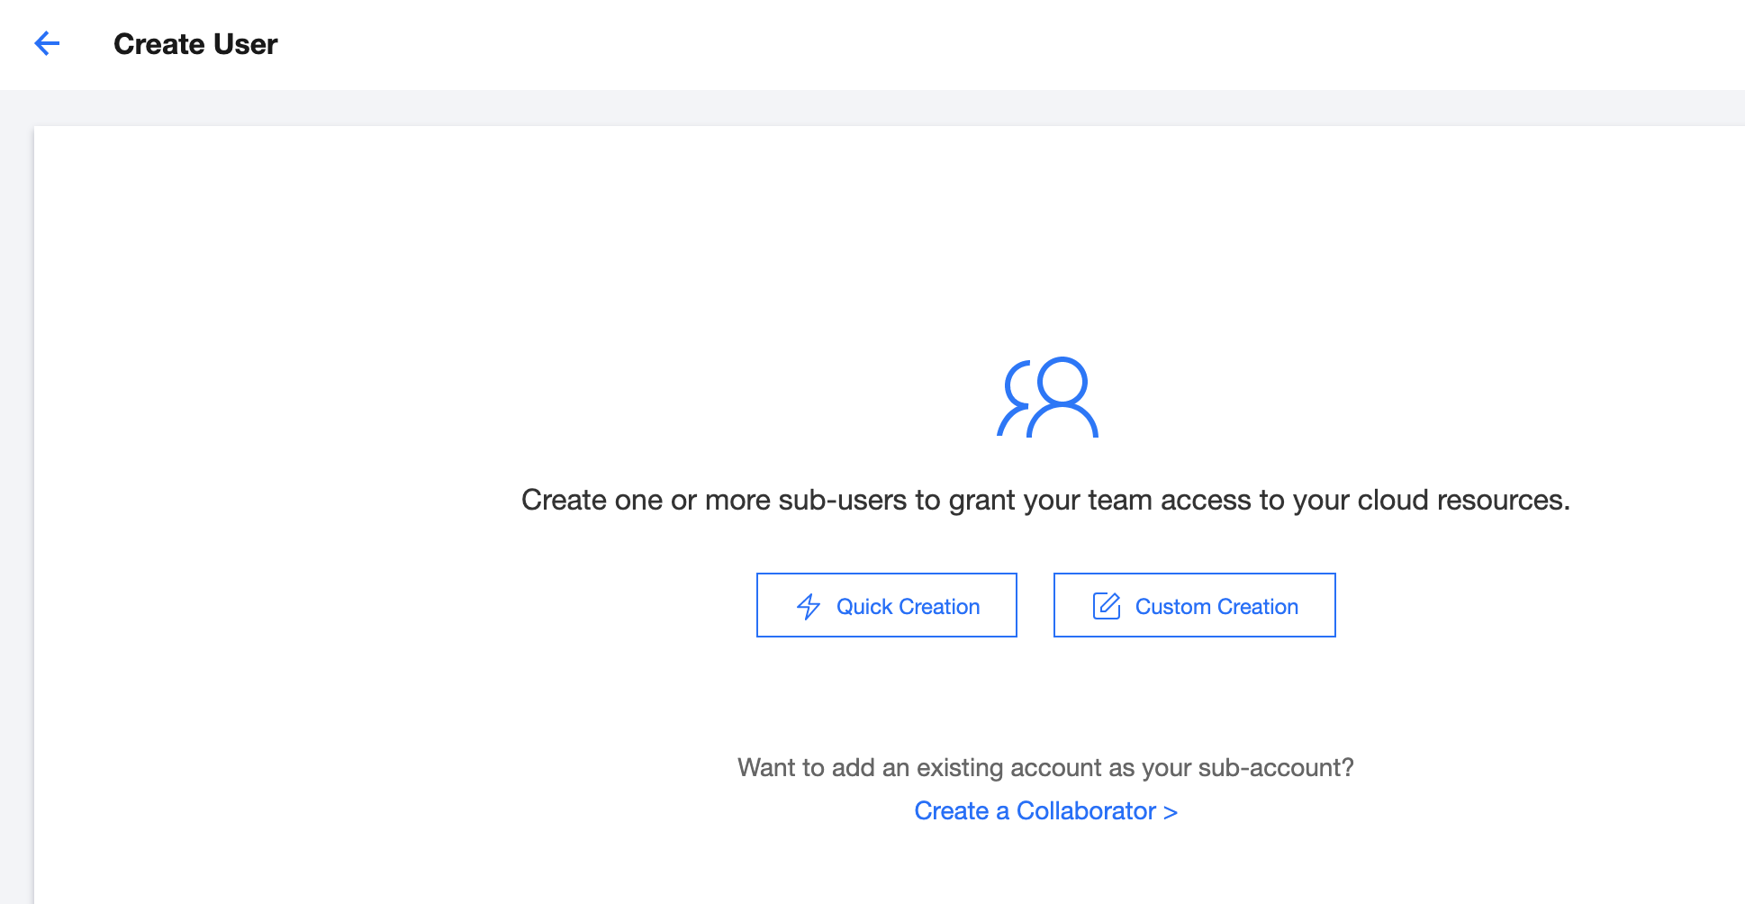
3.4 Use of sub-accounts in Tencent Cloud
Sub-Accounts are created to manage resources in the cloud
Notes:
Creating sub-accounts, mainly to accomplish the need for resource management on the cloud.
Tencent Cloud supports the creation of three types of sub-accounts.
Sub-users
Collaborators
Message Recipients
The difference is that different types of sub-accounts have different permissions.

Slide 52
3.4.1 Comparison of account types
Comparison of account types:
Account Type | Root Account | Sub-Account
 |  | Sub-User | Collaborator | Message Recipient
Console access | ✔ | ✔ | ✔ | -
Programming access | ✔ | ✔ | ✔ | -
Policy authorization | It has all policies by default | ✔ | ✔ | -
Message notification | ✔ | ✔ | ✔ | ✔

Slide 53
3.4.2 Sub-Account scenarios and architecture
Scenario 1:
An enterprise has many Tencent Cloud resources, including CVM instances, VPC instances, CDN instances, and COS buckets and objects. It has many employees such as developers, testers, and OPS engineers. Developers require read/write permissions for Tencent Cloud resources on the development servers for their projects, testers require read/write permissions for resources on the test servers, and OPS engineers are responsible for the purchase and daily operations of such servers. The corresponding permissions will be revoked when the responsibilities or projects of employees change.
Scenario 2:
An enterprise has many Tencent Cloud resources, and it wants to focus on product R&D and delegate the OPS of such resources to a service provider. The corresponding management permissions will be repossessed when the contract with the service provider is terminated.

Slide 54
Course summary
This course covers:
Cloud security systems and standards: cloud security principles, cloud security standards, security responsibility sharing model, and Tencent Cloud security system
Tencent Cloud data security solutions
Access management in Tencent Cloud

Slide 55
Thank you!

